Slide 1
R
KNN
k-nearest neighbors

Slide 2
Machine learning algorithm called “KNN” or k-nearest neighbors.
The KNN or k-nearest neighbors algorithm is one of the simplest machine learning algorithms and is an example of instance-based learning, where new data are classified based on stored, labeled instances.

Slide 3
similarity measure is typically expressed by a distance measure such as the
Euclidean distance,
cosine similarity or
the Manhattan distance.

Slide 4
The k-nearest neighbor algorithm adds to this basic algorithm that after the distance of the new point to all stored data points has been calculated, the distance values are sorted and the k-nearest neighbors are determined.

Slide 5
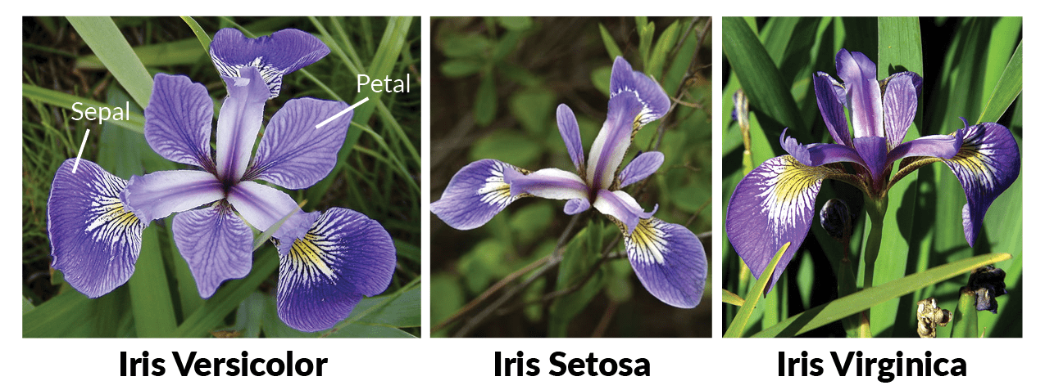

Slide 6
Normalization
KNN – Predicts Value
Training set
Predict Type –M or B Type Eg:
For M – 60% M – 40% B

Slide 7
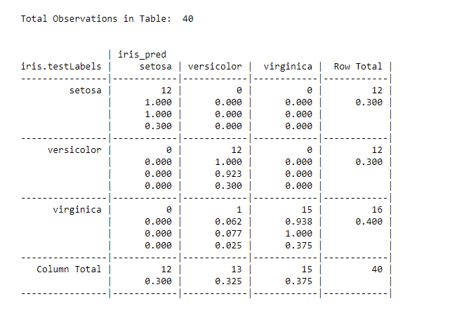

Slide 8
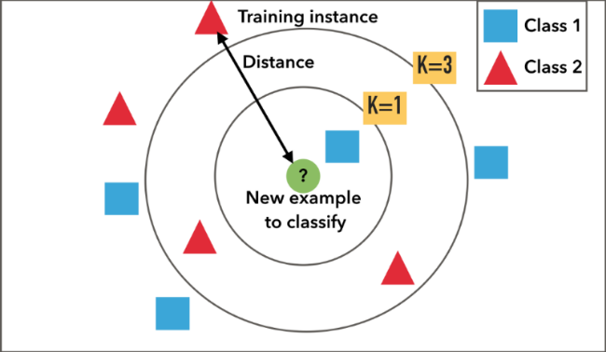

Slide 9
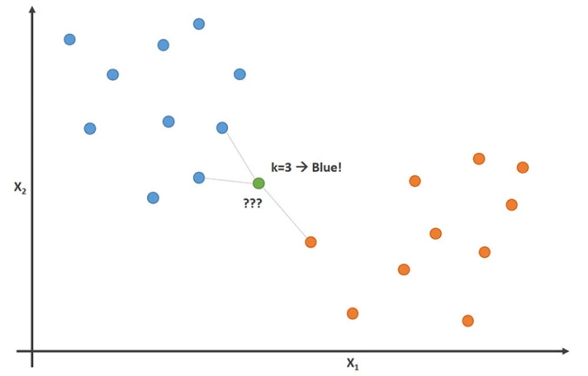

Slide 10
